Slide 1
The Federal CARES Act
MAJOR PROVISIONS | IMPLEMENTATION | RESOURCES
Notes:
Speaker: Michelle

Slide 2
Overview & Major Provisions for Individuals
$2 Trillion Package
Through the Federal Reserve potential for additional $4 trillion in support for the economy
Referred to as the “Phase 3” Bill
Automatic Payments to Individual Taxpayers
$1,200 per individual ($2,400 joint return) + $500 per child
Phased out for incomes above $75,000 ($150,000 joint)
Expanded Unemployment
Most restrictions on eligibility suspended if related to COVID-19
Additional $600 per week on top of regular state benefit (through July 31)
Eligibility ends when individual can return to work
Benefits provided through State UI offices

Slide 3
Major Provisions for Employers
All Employers
Tax Changes
Employee Retention Credit
Larger Employers
Loans, Loan Guarantees, Federal Reserve Credit Facilities
Small Businesses, Self-Employed, Independent Contractors, & Non-Profits
Paycheck Protection Program
SBA Economic Injury Disaster Loans (EIDL)
Paid Sick and FMLA Leave

Slide 4
All Employers
Payroll Taxes
Delay payment of employer payroll taxes (Social Security) between now and 1/1/21
50% due 12/31/21 and 50% due 12/31/22
Does not apply to employers who have loans forgiven under Paycheck Protection Program
Tax Changes
Net Operating Loss (NOL) for ’18, ‘19, & ’20 can be carried back 5 years, suspend 80% limitation, extends to pass-throughs and sole proprietors
Accelerate recovery of AMT credits
Election to increase limit on interest deductibility to 50% for ‘19 & ’20
Qualified Improvement Property (QIP) fix

Slide 5
All Employers
Employee Retention Credit
Employers fully or partially shutdown or with 50% drop in gross receipts in a quarter compared to prior year (until return to 80%)
Refundable tax credit for 50% of the wages (including employers health plan expenses) paid by the employer up to $10,000 per employee
Employers with more than 100 employees applies to employees not providing services
Employers with 100 or less employees applies to all employees paid during the eligible period
Employers are not eligible if they receive a Paycheck Protection Program loan
Allows for advance payment of the credit

Slide 6
Mid-Size & Larger Employers
Loans, Loan Guarantees, Federal Reserve Credit Facility
$454 Billion to the Treasury Department for loans, loan guarantees, or to support Federal Reserve Credit Facilities
Special programs for airline industry and critical national security businesses
Restrictions on stock-buy-backs and executive compensation
Likely to see new programs through the Federal Reserve that will support lending by financial institutions to businesses

Slide 7
Small Businesses, Self-Employed, ICs, Non-Profits
Paycheck Protection Program
$349 Billion in loans for small business (generally less than 500 employees), 501(c)(3)s, self-employed, sole proprietors, and independent contractors
Loans equal to the lesser of 2 ½ months of average payroll or $10 million
Loans by local and national lenders
Minimal requirements (e.g. no collateral, no personal guarantee)
Loans convert to grants equal to amount spent on payroll, rent, interest on mortgage, and utilities for the 8 weeks after origination
Loan forgiveness is reduced proportionally if the employer reduces number of FTEs
Loan forgiveness is reduced if employer reduces wages by more than 25%
Employer can avoid reduction in forgiveness if they bring back employees and restore wages generally within 30 days and maintain through June 30

Slide 8
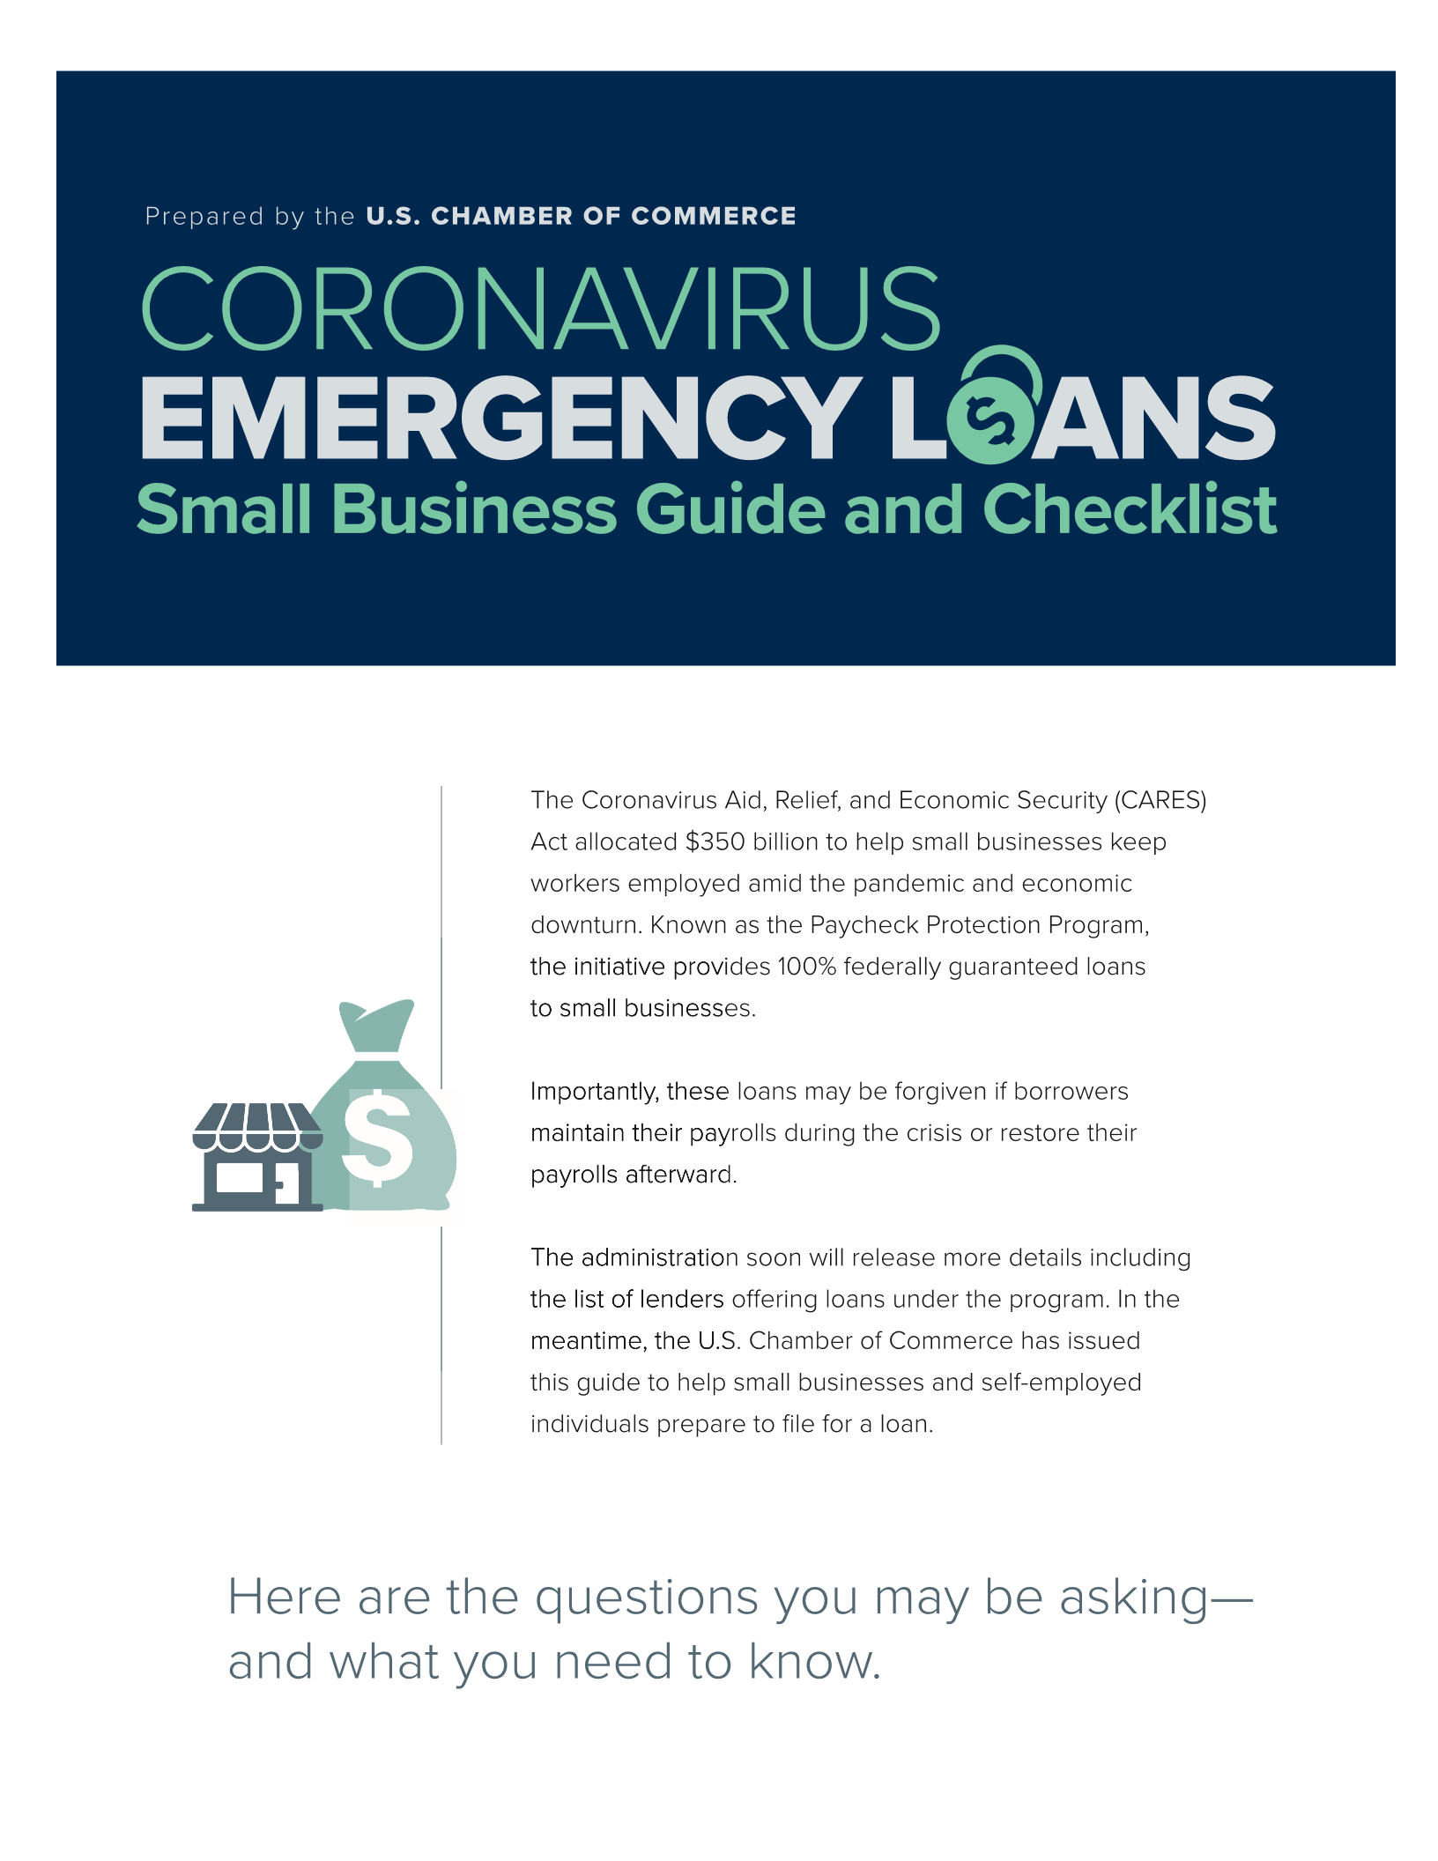
Learn More About the
Paycheck Protection Program
Download our guide:
www.uschamber.com/sbloans

Slide 9
Small Businesses, Self-Employed, ICs, Non-Profits
SBA Economic Injury Disaster Loans
Small businesses and non-profits (including faith-based) with fewer than 500 employees, sole proprietors, independent contractors
Up to $2 million working capital loan up to 30-year term; 3.75% (2.75% non-profits)
Payments deferred up to 1 year
Loans based on credit scores; no tax returns required
Up to $200,000 without a personal guarantee
No collateral for $25,000 or less; general security interest instead of real-estate for larger loans
$10,000 emergency grant within 3 days that does not have to be repaid
Interacts with Paycheck Protection Program
Apply through SBA.gov

Slide 10
Paid Sick Leave – From Phase 2 Bill
Employers with less than 500 employees are required to provide 10 days of paid sick leave, if leave is related to COVID-19
Sick leave can be taken when ill, quarantined due to exposure, to take care of a sick or quarantined family member, or to take care of a child during a school closure
Leave is paid at regular rate with a maximum of $511 per day if taking care of self; paid at 2/3 rate with a maximum of $200 per day if caring for family member
Payment up to the maximum is reimbursed by the federal government
Leave is in addition to any other leave an employer already provides
Businesses with less than 50 employees may be exempt from providing leave related to caring for a child whose school or daycare is closed if providing leave threatens the viability of the business
Paid sick leave is not available if an employee can telework

Slide 11
Paid FMLA Leave – From Phase 2 Bill
Employers with less than 500 employees are required to provide up to 10 weeks of paid FMLA leave if an employee needs to take care of a child due to a school or child care closure caused by COVID-19
Leave is paid at 2/3 regular pay at a maximum of $200 per day and $10,000 in the aggregate
Paid FMLA is in addition to any leave an employer provides
Payments for FMLA leave will be reimbursed by the federal government up to the maximum
Businesses with less than 50 employees may be exempt from providing leave related to caring for a child whose school or daycare is closed if providing leave threatens the viability of the business
Paid leave is not available if an employee can telework

Slide 12
Get More Information
www.uschamber.com
Small Business Resources: www.uschamber.com/co

